Slide 1

Department of Computer Science & Engineering
SIGN LANGUAGE TRANSLATOR FOR SPEECH-IMPAIRED
Date: 29 June 2021
SOMIREDDYGARI SAMIKSHA : 17WH1A0516
TURIYA DANDU : 17WH1A0536
THONDAPU NEELIMA CHOWDARY : 17WH1A0545
Internal Guide: Mrs. Naga Kalyani.Ayyadevara
Designation : Assistant Professor
BVRIT HYDERABAD College of Engineering for Women

Slide 2
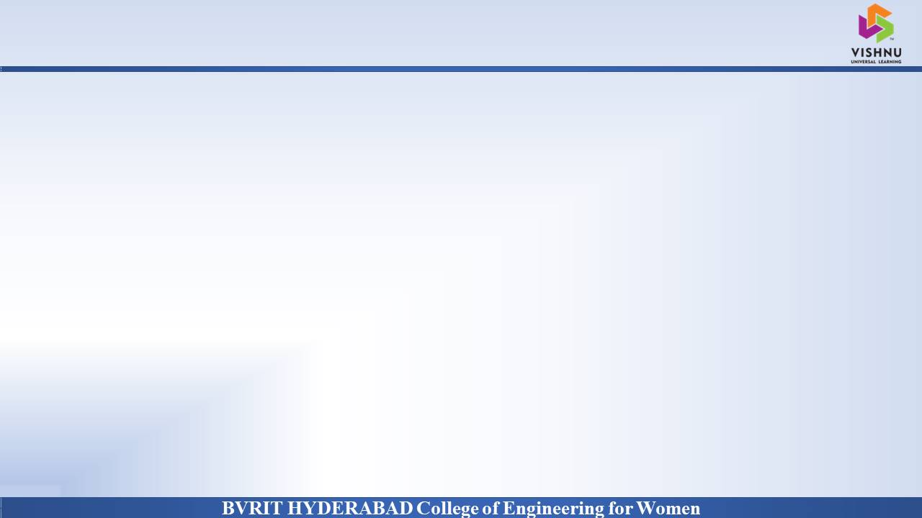
Why Should I Study this course?
Abstract
PROBLEM STATEMENT
Examples
Our project aims to create a computer application and train a model which when shown a real time video of hand gestures of sign language shows the output for that particular sign in text format
PROBLEM OBJECTIVE
Although a certain fraction of the world suffers from speech and hearing disabilities, Sign Language is not a wide spread language across the world.
Therefore, to aid with a smoother communication between speaking and non-speaking world, technical development can be introduced. This project proposes an application for it.
BVRIT HYDERABAD College of Engineering for Women

Slide 3
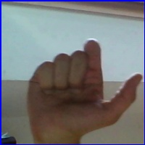
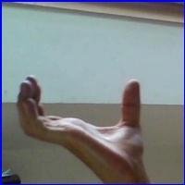
DataSet
Dataset is a collection of images of alphabets from ALS, separated in 29 folers which represent various class.
Content
The training dataset contains 87,000 images of 200x200 pixes 29 classes of which 26 are letters(A to Z) and 3 classes for space, delete & nothing.
BVRIT HYDERABAD College of Engineering for Women

Slide 4
Architecture
Data acquisition
Data preprocessing
Building a deep learning model based on CNN
Class Recognition
BVRIT HYDERABAD College of Engineering for Women

Slide 5
CNN
What is CNN: A convolutional neural network, or CNN, is a deep learning neural network designed for processing structured arrays of data such as images.
Features:
Image analysis
How CNN is better traditional networks
Layers in CNN
BVRIT HYDERABAD College of Engineering for Women

Slide 6
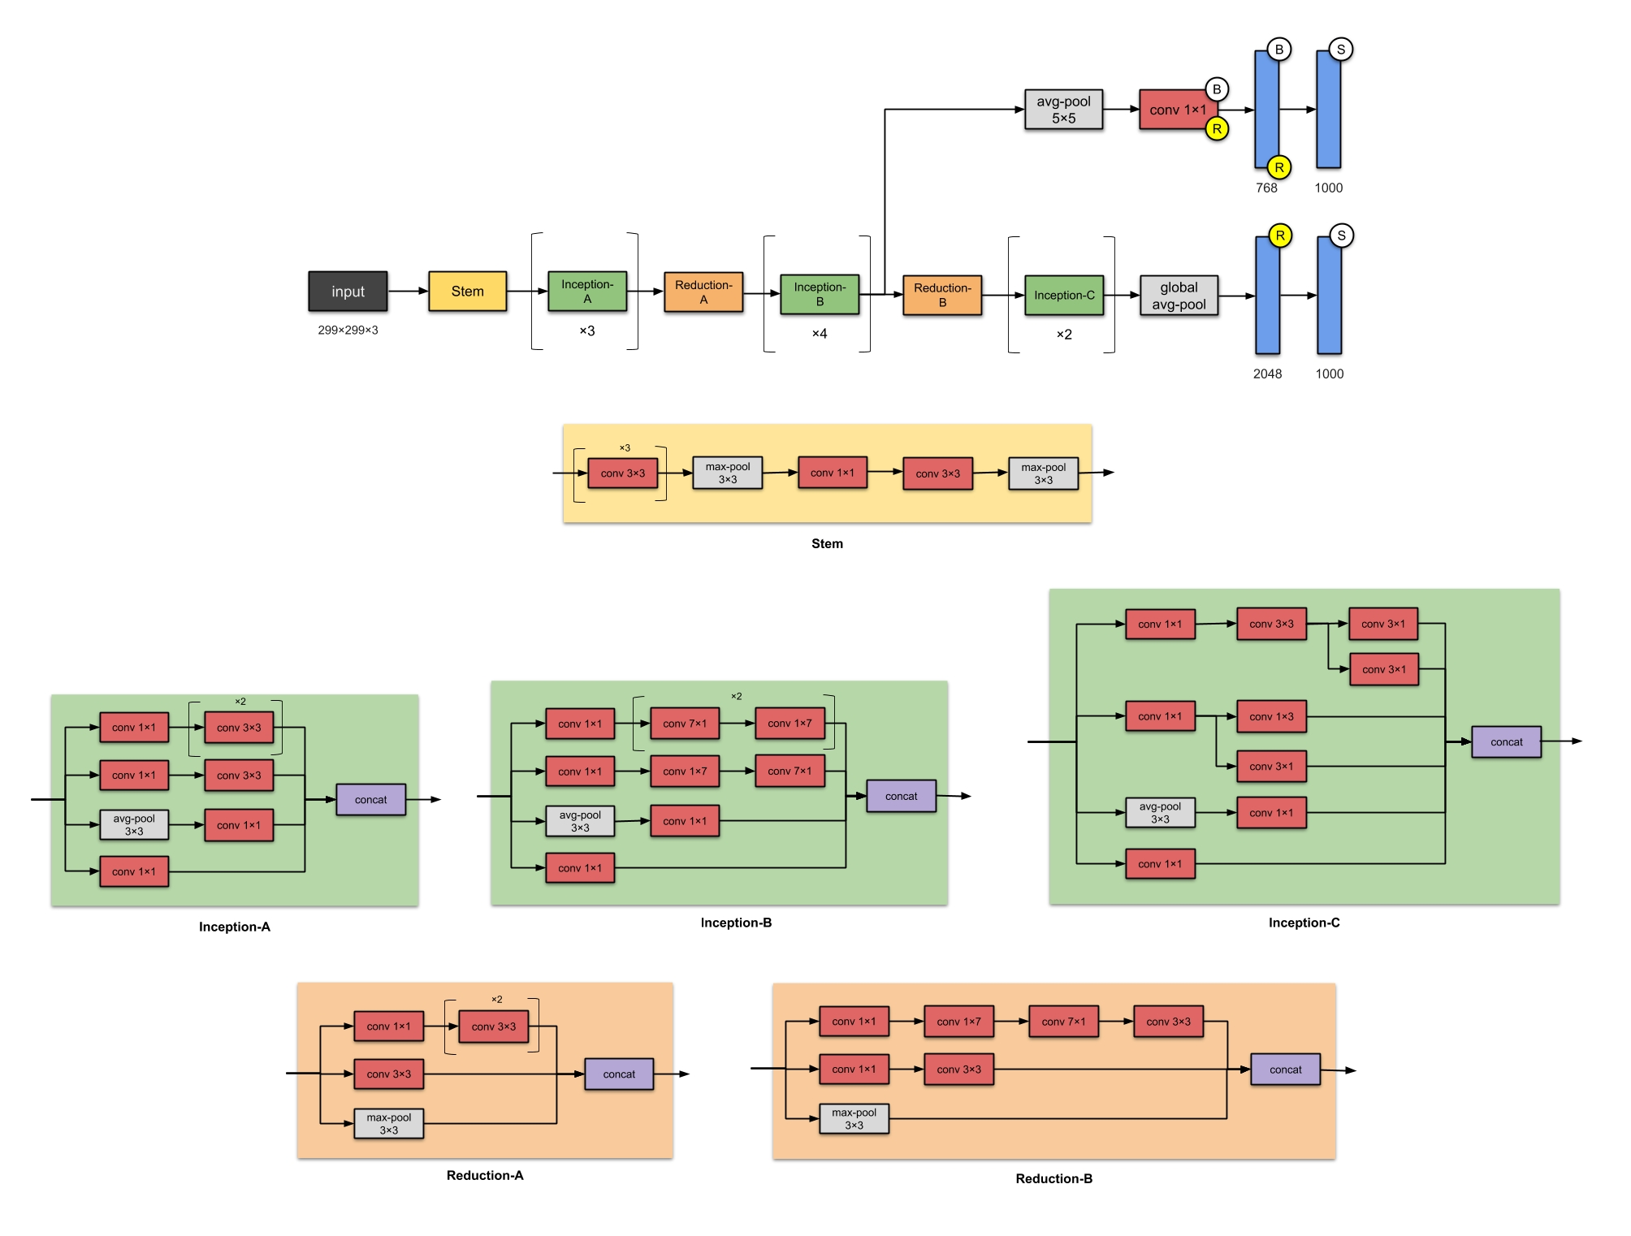
Inception V3
BVRIT HYDERABAD College of Engineering for Women

Slide 7
Technology Stack
Python Language
Machine learning
CNN
Packages & Libraries
Numpy, os, cv2
Tensorflow
Matplotlib
BVRIT HYDERABAD College of Engineering for Women

Slide 8

SYSTEM SPECIFICATIONS
ENVIRONMENT | SPECIFICATIONS
HARDWARE | Processor - Intel Core i5 Memory(RAM) - 8GB Storage - 1TB
SOFTWARE | Python(tensorflow) OS- Windows 10 Anaconda Prompt
BVRIT HYDERABAD College of Engineering for Women

Slide 9
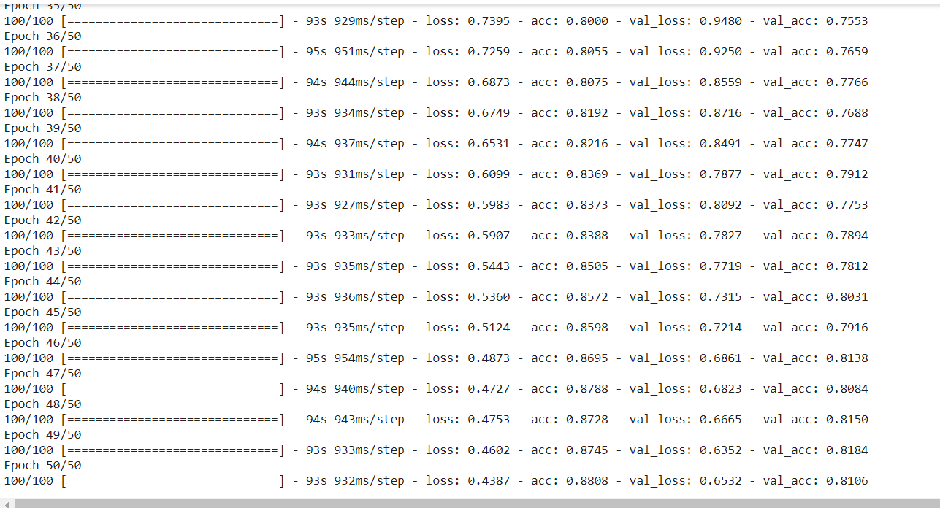
Training Output
BVRIT HYDERABAD College of Engineering for Women

Slide 10
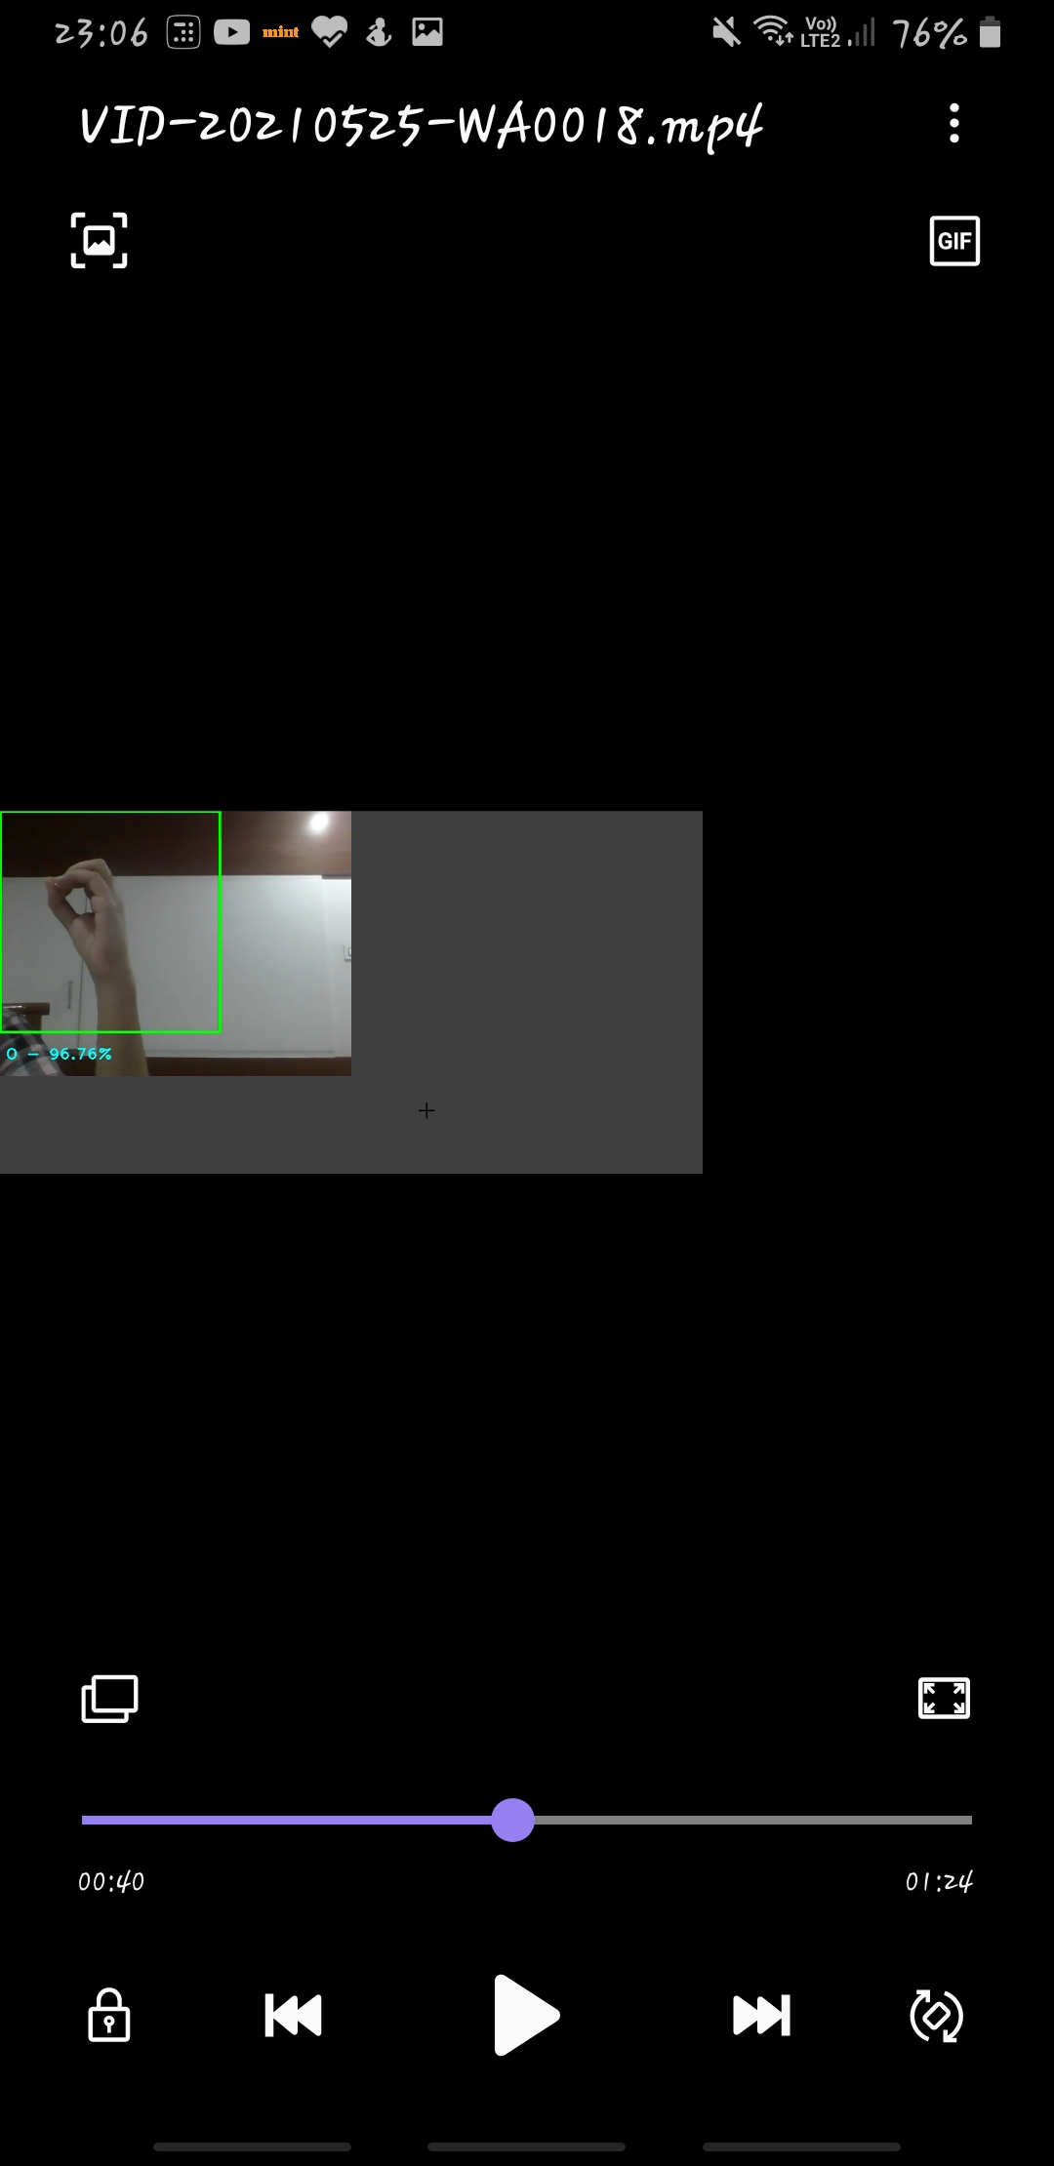
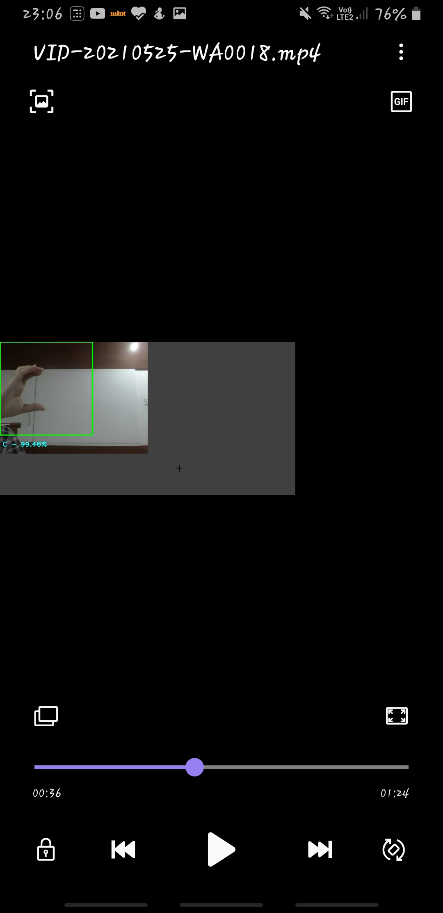
Output
BVRIT HYDERABAD College of Engineering for Women

Slide 11
Test Cases
TestCase ID | Test Scenario | Expected Result | Actual Result | Pass/Fail
TC01 | Check if webcam is switched on | As soon as program is excuted, webcam switched on | As Expected | Pass
TC02 | Checke if video sequentlly are divided into frames for processing | To Process the given hand gesture, each frame is captured from video sequences | As Expected | Pass
TC03 | Check if bouding box is displayed | As soon as program is excuted, bounding box(Green box) displayed | As Expected | Pass
TC04 | Check if hand gesture is deteceted | As soon as hand gesture will be detected | As Expected | Pass
TC05 | Check if alphabet along with its confidence is dipalyed or not | After prediction happens, alphabet along with its confidence for that respective gesture is dispalyed | As Expected | Pass
TC06 | Check if nothing is displayed, when nothing is infront of camera | Nothing will be displayed, if no gesture is placed. | As Expected | Pass
BVRIT HYDERABAD College of Engineering for Women

Slide 12
References
Base Paper:
https://ieeexplore.ieee.org/document/9225422
Convolutional Neural Network:
https://medium.com/nybles/a-brief-guide-to-convolutional-neural-network-cnn-642f47e88ed4
Data Set:
https://www.kaggle.com/grassknoted/asl-alphabet
BVRIT HYDERABAD College of Engineering for Women

Slide 13
Thank you
BVRIT HYDERABAD College of Engineering for Women

